Slide 1

“BLOG WEBSITE”
Task - 2

Slide 2
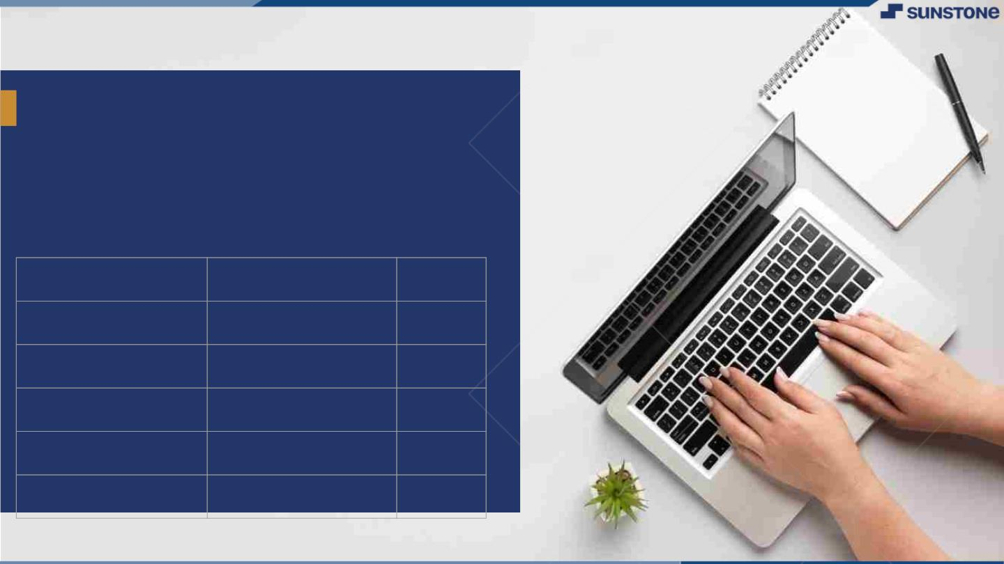
BLOG WEBSITE
The main purpose of blog website is to convey information in a way that is more formal or conversational than other long-form written content.
LMS Username
Name
Batch
Chandr
au111420243004 | Chandru S V | CA11
au111420243005 | Deepa R | CA11
au111420243023 | Swetha S | CA11
au111420243301 | Harish D P | CA11
au111420243004
CA10
au111420205028
NithyaShri RR
CA10
au111420205044
Sneha G
CA10
au111420205049
Vemuri Harika Chowdary
CA10

Slide 3

Task - 2
Create UI and implement various components using react
●
●
●
Split design into components and Higher order Components
Define structure of the components
Set the basic ui components with dummy data
Integrate the APIs to frontend to ensure the dynamic feature of website
●
●
●
●
●
Point base api to the severs base url
Design api calls for each element
Handle errors in the output
Render output of apis to different low level components
Secure content of post apis
Evaluation Metric:
100% Completion of the above tasks
Learning Outcome
▪
▪
▪
▪
Developing complicated UI using react components
Using props drilling and context to pass variables
Getting familiar with different type of api calls
Handling different input data

Slide 4

Step-Wise Description
1. Planning and Design:
Define the Website Structure: Outline the sections like Home, Recipes, Blog, About, Contact, etc.
2. Component Creation:
Design Components: Plan and create individual components for different sections of your website, such as header, footer, recipe cards, blog posts, etc.
3. Fetch Data:
API Integration: Integrate with APIs that provide recipe data or content for your blog.
4. Styling and UI:
CSS Styling: Apply styles to your components for a visually appealing interface.
Responsive Design: Implement responsive design principles to ensure your website looks good on various devices.

Slide 5
Step-Wise Description
5. Content Creation:
Create Sample Content: Generate mock recipes, blog posts, and images to populate your site during development.
6. Deployment:
Hosting: Choose a hosting platform suitable for React apps (e.g., Netlify, Render).
Build and Deploy: Use the appropriate build commands to create a production build and deploy it on your chosen hosting service

Slide 6
Design into Components
About Page:
Author Bio: Share information about yourself and your cooking background.
Mission Statement: Clearly state the purpose and focus of your food blog.
High-Quality Images: Include pictures related to your culinary journey.
Social Media Feed Component:
Display a feed of your latest social media posts.
Encourage users to follow you on platforms like Instagram, Pinterest, or YouTube..
Search Results Component:
Show search results in a clear and organized manner.
Include relevant recipe images, titles, and a brief description.
Responsive Design:
Ensure that all components are optimized for various screen sizes, from desktop to mobile.

Slide 7
Summary of your task
The Blog Website serves as a user-friendly platform for sharing their blogs. Creating a food blog website using ReactJS involves an engaging and dynamic approach to sharing culinary experiences. Leveraging React's component-based architecture, you can craft a user-friendly interface with seamless navigation. Integrating with APIs allows you to fetch and display recipes and with responsive design principles, your blog becomes accessible across various devices, ensuring a visually appealing layout. Using React Router, you can effortlessly manage different sections like recipes, blog posts, and user interactions. Altogether, the use of ReactJS empowers the creation of an interactive, efficient, and visually captivating food blog website.

Slide 8
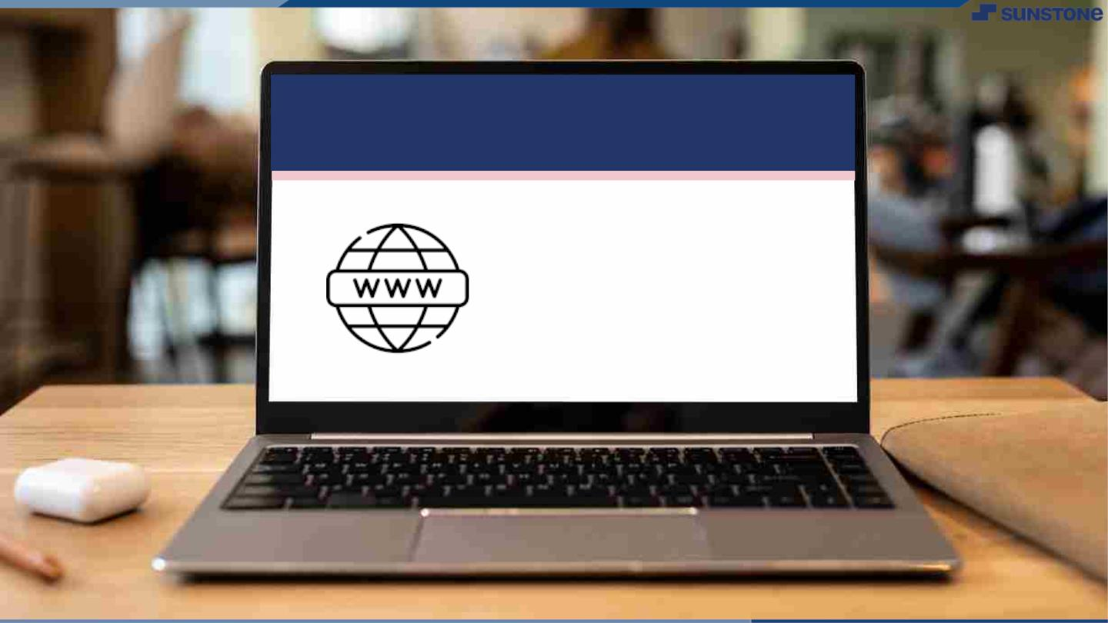
Submission Github
https://github.com/chandru0827/Blog_Website.git

Slide 9


